Slide 1
A Tour of Computer Systems
60080013: Computer Organization
1st Lecture
Instructor:
Sun Heng

Slide 2
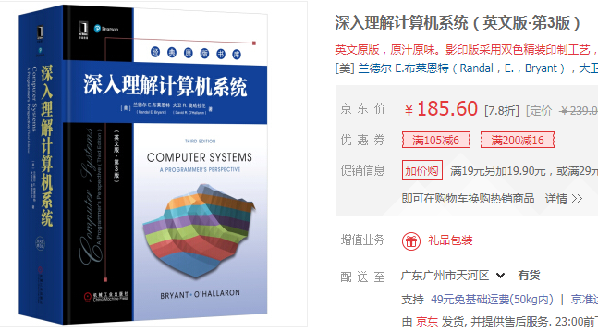
Textbooks
Randal E. Bryant and David R. O’Hallaron,
  Computer Systems: A Programmer’s Perspective, Third Edition, Pearson, 2017
  深入理解计算机系统（英文版·第3版）

Slide 3
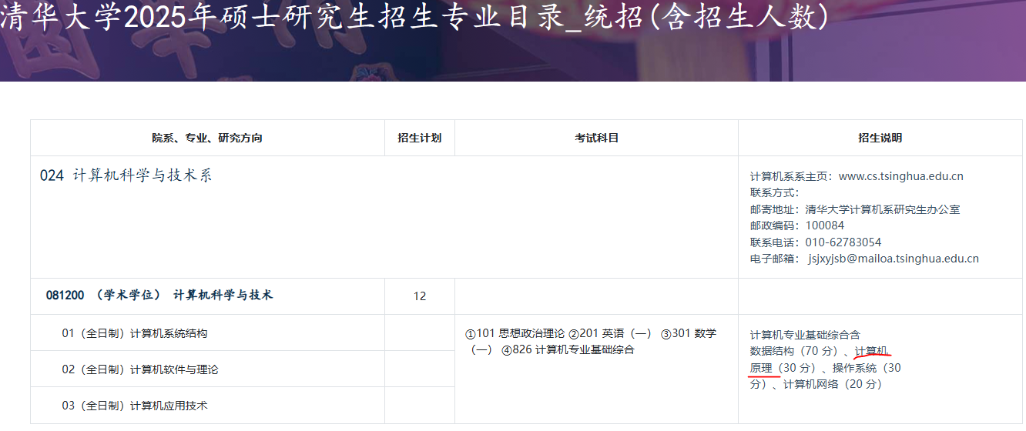
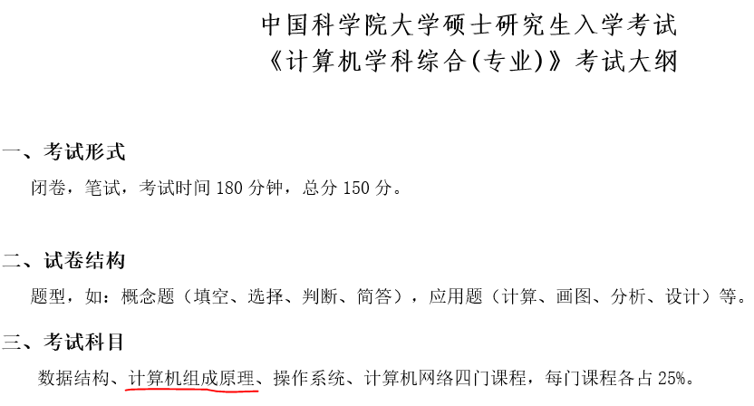
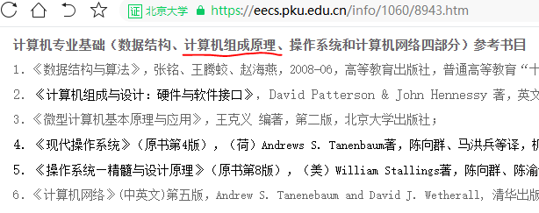
Motivation
Computer Organization is a necessary subject for Graduate Record Examination in many chinese universities.

Slide 4
Concepts
Computer systems consist hardware and systems software that work together to run programs
Specific implementations of systems change over time
But the underlying concepts do not
All computer systems have similar hardware and software components that perform similar functions

Slide 5
What happens and why, when you run hello on your system ?
1 # include <stdio.h>
2 int main()
3 {
4 printf(“hello, world\n”);
5 }

Slide 6
Information is bits
The source program is a sequence of bits
  each with a value of 0 or 1,
Bits organized in 8-bit chunks called bytes.
  Each byte represents some text character in the program.
Most modern systems represent text characters using the ASCII standard
  that represents each character with a unique byte-sized integer value.

Slide 7
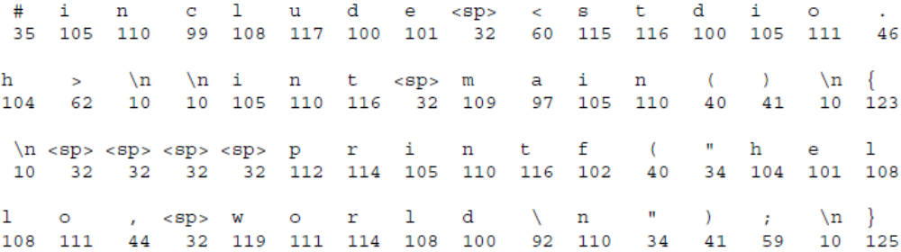
ASCII representation of Hello.c code

Slide 8
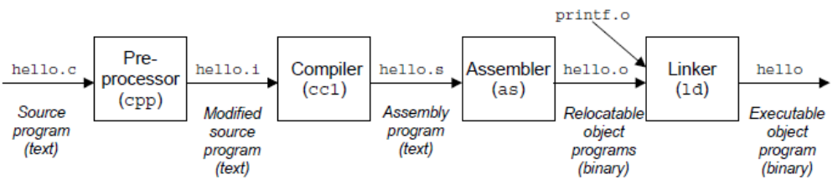
The compilation system
The programs that perform the four phases (preprocessor, compiler, assembler, and linker) are known collectively as the compilation system.
gcc –o hello hello.c

Slide 9
Preprocessing phase
The preprocessor (cpp) modifies the original C program according to directives that begin with the # character. For example, the #include <stdio.h> command in the hello.c tells the preprocessor to read the contents of the system header file stdio.h and insert it directly into the program text. The result is another C program, typically with the .i suffix.

Slide 10
Compiler phase
The compiler (cc1) translates the text file hello.i into the text file hello.s, which contains an assembly-language program. Each statement in an assembly-language program exactly describes one low-level machine-language instruction in a standard text form. Assembly language is useful because it provides a common output language for different compilers for different high-level languages. For example, C compilers and C++ compilers both generate output files in the same assembly language.

Slide 11
Assembler phase
The assembler (as) translates hello.s into machine-language instructions, packages them in a form known as a relocatable object program, and stores the result in the object file hello.o. The hello.o file is a binary file whose bytes encode machine language instructions rather than characters. If we were to view hello.o with a text editor, it would appear to be gibberish.

Slide 12
Linker phase
The C program always calls some functions, which are part of the standard C library provided by every C compiler. The functions reside in separate precompiled object files, which must somehow be merged with our hello.o program. The linker (ld) handles this merging. The result is the hello file, which is an executable object file (or simply executable) that is ready to be loaded into memory and executed by the system.

Slide 13
Running the hello Program
CPU
Register file
ALU
Reading hello command
PC
System bus
Memory bus
Main
memory
"hello"
Bus interface
I/O
bridge
I/O bus
Expansion slots for
other devices such
as network adapters
USB
controller
Graphics
adapter
Disk
controller
Mouse
Keyboard
Display
Disk
User
types
"hello"

Slide 14
Running the hello Program
CPU
Register file
Displaying the output
ALU
PC
System bus
Memory bus
Main
memory
"hello,world\n"
Bus interface
I/O
bridge
hello code
I/O bus
Expansion slots for
other devices such
as network adapters
USB
controller
Graphics
adapter
Disk
controller
Mouse
Keyboard
Display
Disk
hello executable
stored on disk
"hello,world\n"

Slide 15
Cache Memory
An important lesson from simple example is that a system spends a lot of time moving information from one place to another.
CPU chip
L1
cache
(SRAM)
Register file
ALU
Cache bus
System bus
Memory bus
Main
memory
(DRAM)
L2 cache
(SRAM)
Bus interface
Memory
bridge

Slide 16
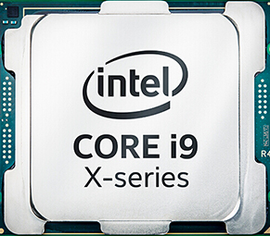
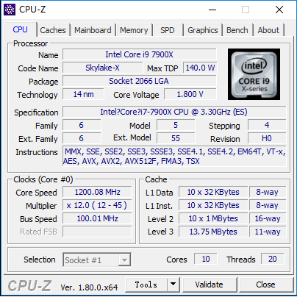
Cache Memory

Slide 17
Memory Hierarchy
L0:
Regs
CPU registers hold words retrieved from cache memory.
Smaller,
faster,
and
costlier
(per byte)
storage
devices
L1:
L1 cache
(SRAM)
L1 cache holds cache lines retrieved from the L2 cache.
L2:
L2 cache
(SRAM)
L2 cache holds cache lines
retrieved from L3 cache
L3:
L3 cache
(SRAM)
L3 cache holds cache lines
retrieved from memory.
Larger,
slower,
and
cheaper
(per byte)
storage
devices
L4:
Main memory
(DRAM)
Main memory holds disk
blocks retrieved from local
disks.
L5:
Local secondary storage
(local disks)
Local disks hold files retrieved from disks on remote network servers.
L6:
Remote secondary storage
(distributed file systems, Web servers)

Slide 18
Virtual Address
Memory
invisible to
user code
Illusion that each process has exclusive use of main memory
Example
  The virtual address space for Linux
0xffffffff
Kernel virtual memory
0xc0000000
User stack
(created at runtime)
Memory mapped region for
shared libraries
printf() function
0x40000000
Run-time heap
(created at runtime by malloc)
Read/write data
Loaded from the
hello executable file
Read-only code and data
0x08048000
Unused
0

Slide 19
Classwork
We have known that some compilers handle source files in several phases in order. Please describe the compiling processes (phases) of GCC.

